Slide 3
Executive Summary
Background: Tourism in Chicago contributes significantly to the local economy. Safety concerns play a critical role in tourist decision-making.
Objectives and Outcomes:
Analyzing crime data in Chicago for actionable safety insights.
Identify high-crime areas and times.
Provide insights to enhance tourist safety.
Propose visual dashboards for better understanding of crime trends.

Slide 4
Data Sources
Dataset:
Chicago Crime Incident Data from (October 15th, 2024)
https://data.cityofchicago.org/Public-Safety/Crimes-One-year-prior-to-present/x2n5-8w5q/about_data
Community Area Boundaries Data from
Boundaries - Community Areas (current) | City of Chicago | Data Portal
Dataset size:
Our dataset has 258062 records and 31 features
Key Features:
Crime types, locations, and timestamps.
Arrest records and geographic coordinates.
Contextual data such as ward and beat information (Subdivisions).
Relevance:
Helps pinpoint unsafe areas and predict crime trends based on historical data.

Slide 5
Data Quality Concerns
22 rows with duplicated case numbers - The first case was retained
9 duplicated rows - All were deleted
1058 rows that are missing Location Description - Missing values replaced with ‘unknown’
92 rows that are missing Latitude and Longitude points - Missing values replaced with ‘unknown’
956 rows that are missing community information - Community names, Shape area and length replaced with ‘unknown’

Slide 6
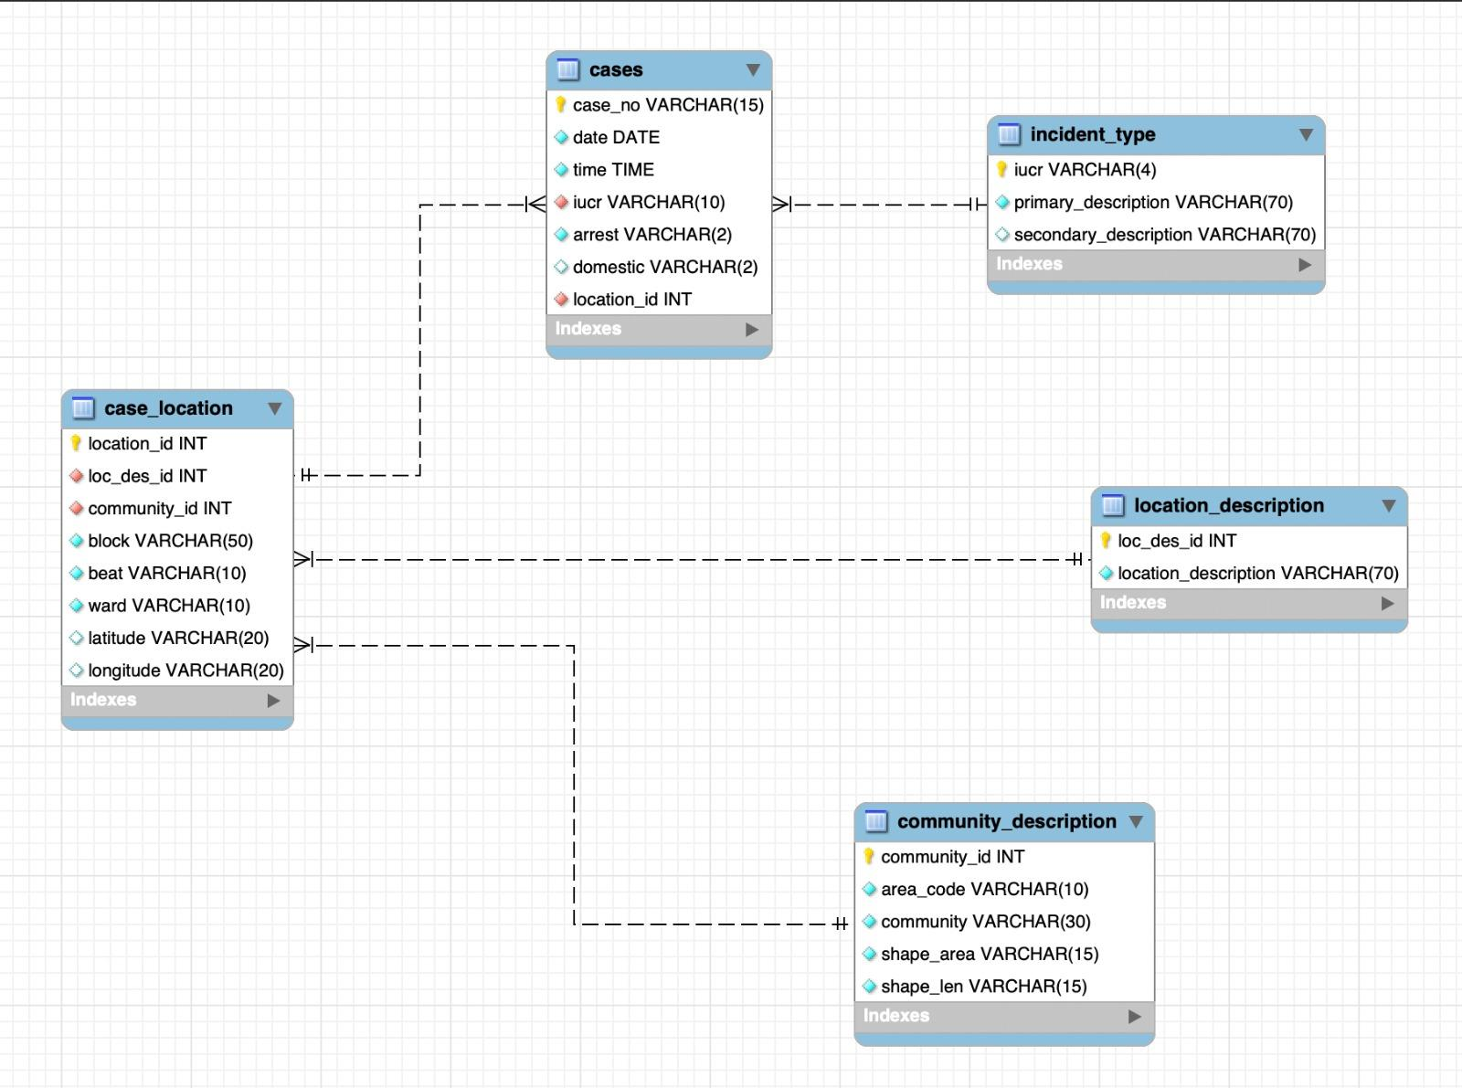
Relational Data Model (3NF)

Slide 7
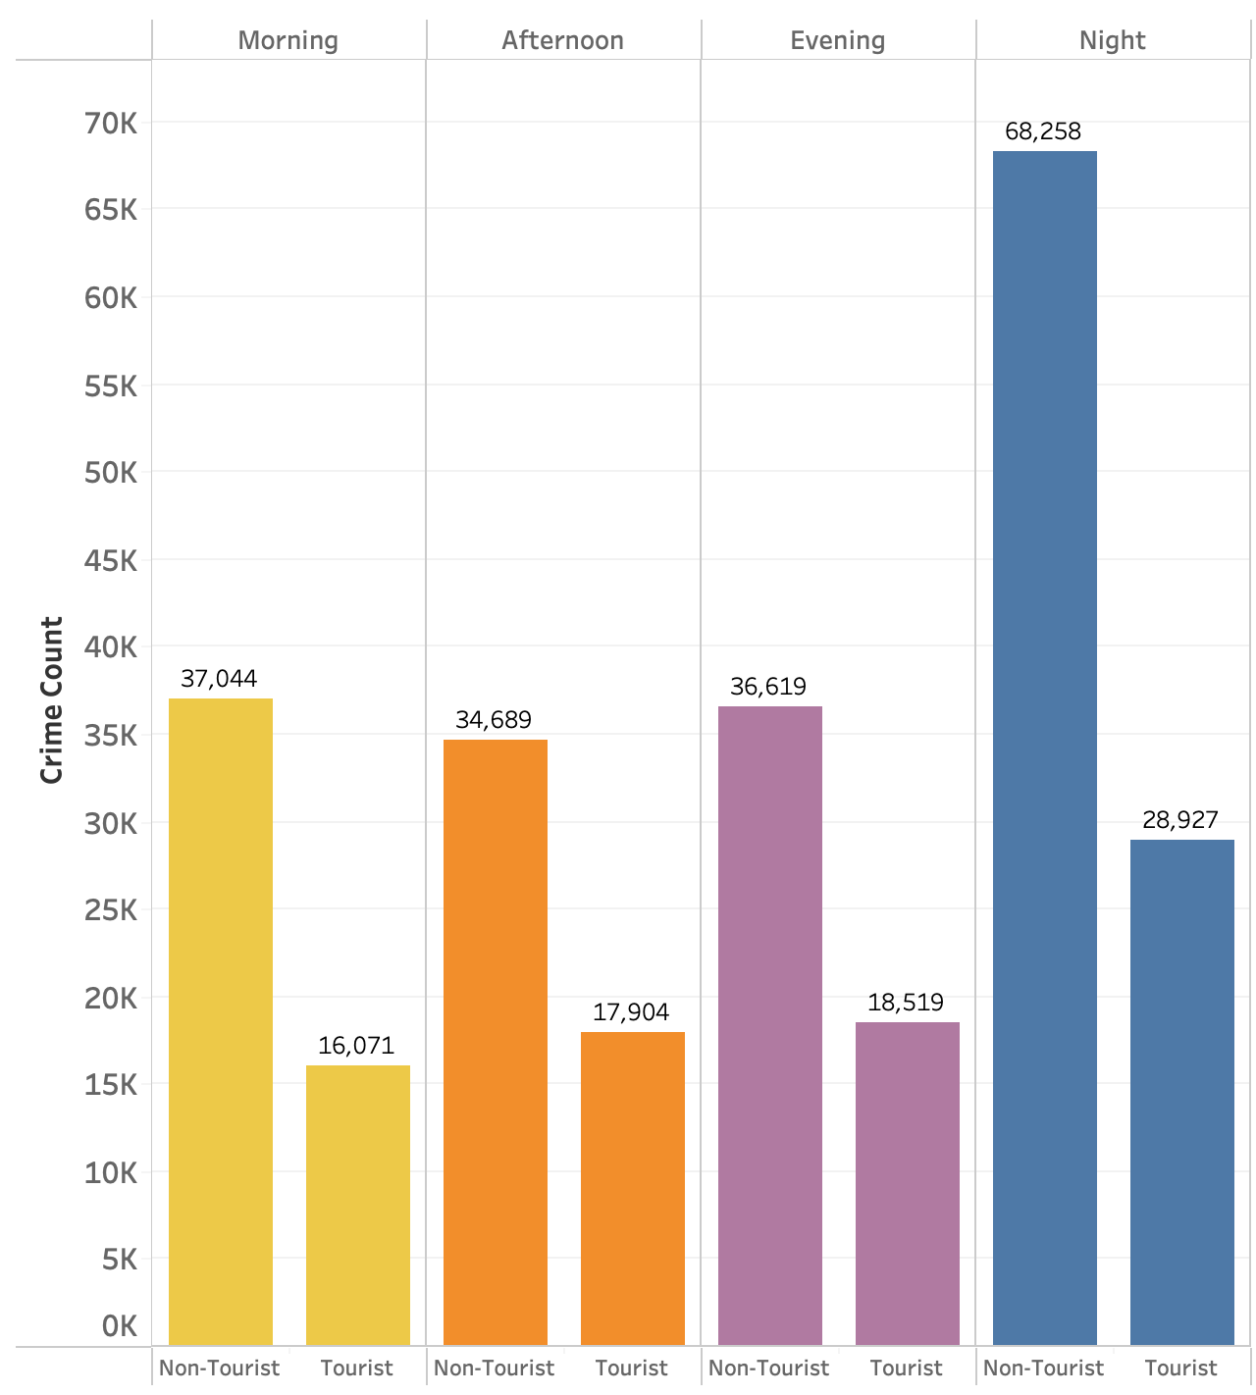
Crime Distribution Across Tourist and
Non-Tourist Neighborhoods
Non-tourist areas experience a significant spike in crimes at night, tourist areas are thus relatively safer for evening and nighttime activities
Across all time periods (morning, afternoon, evening, and night), tourist areas report considerably fewer crimes than non-tourist areas. This is a positive indicator for tourism marketing.
Morning and afternoon crime counts in tourist areas are less than half of those in non-tourist areas highlighting the relative safety of tourist areas for daytime exploration.

Slide 8
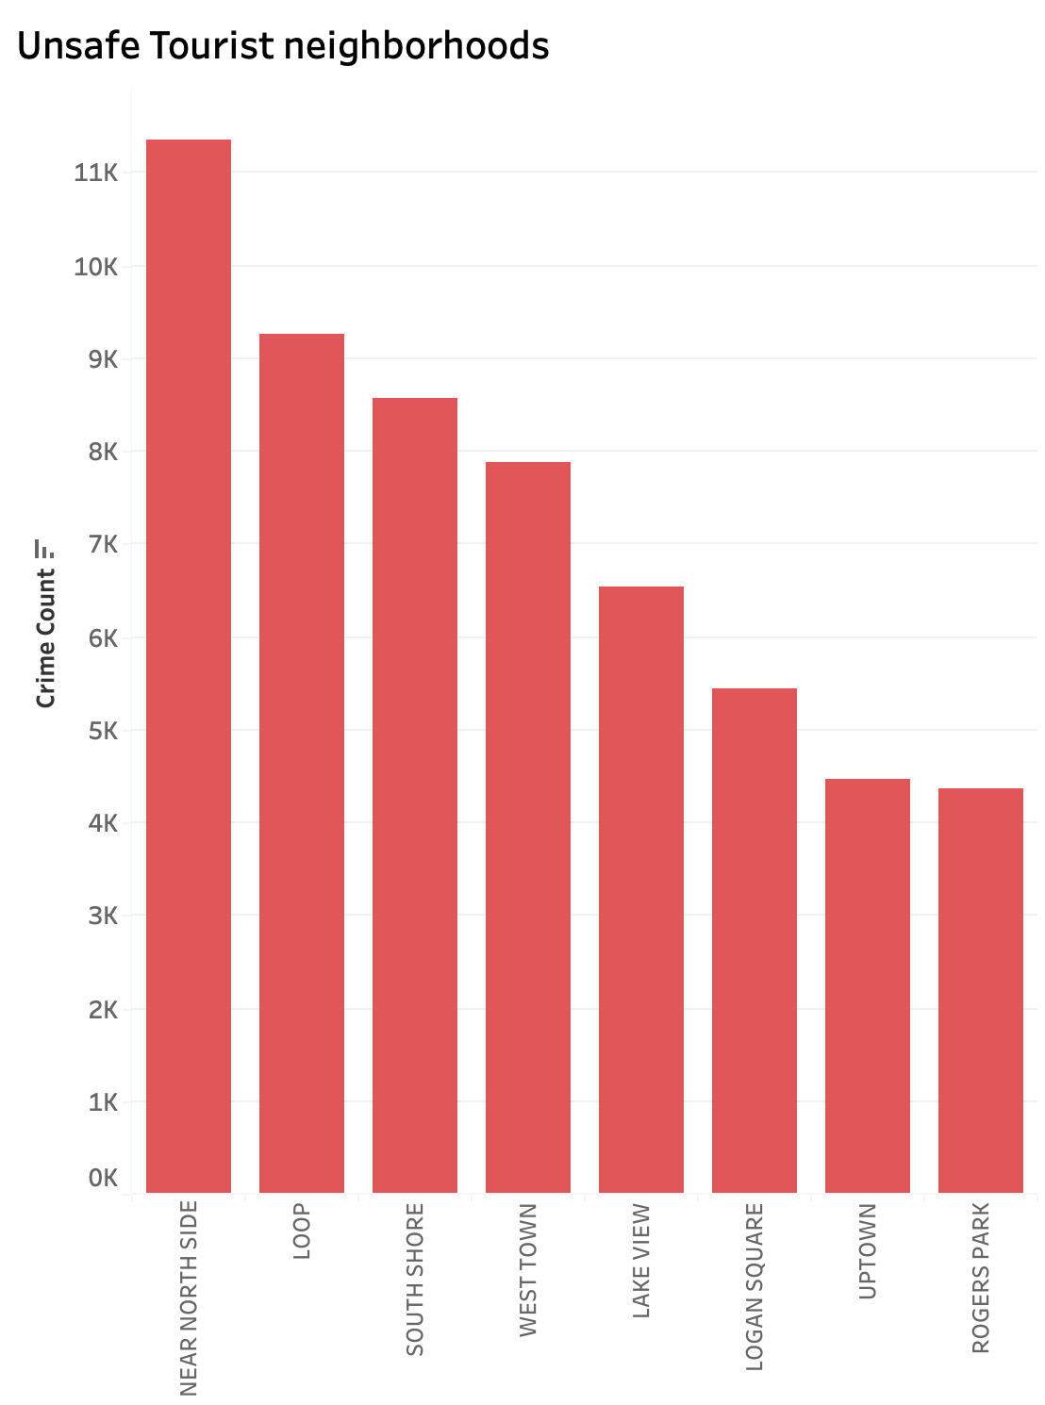
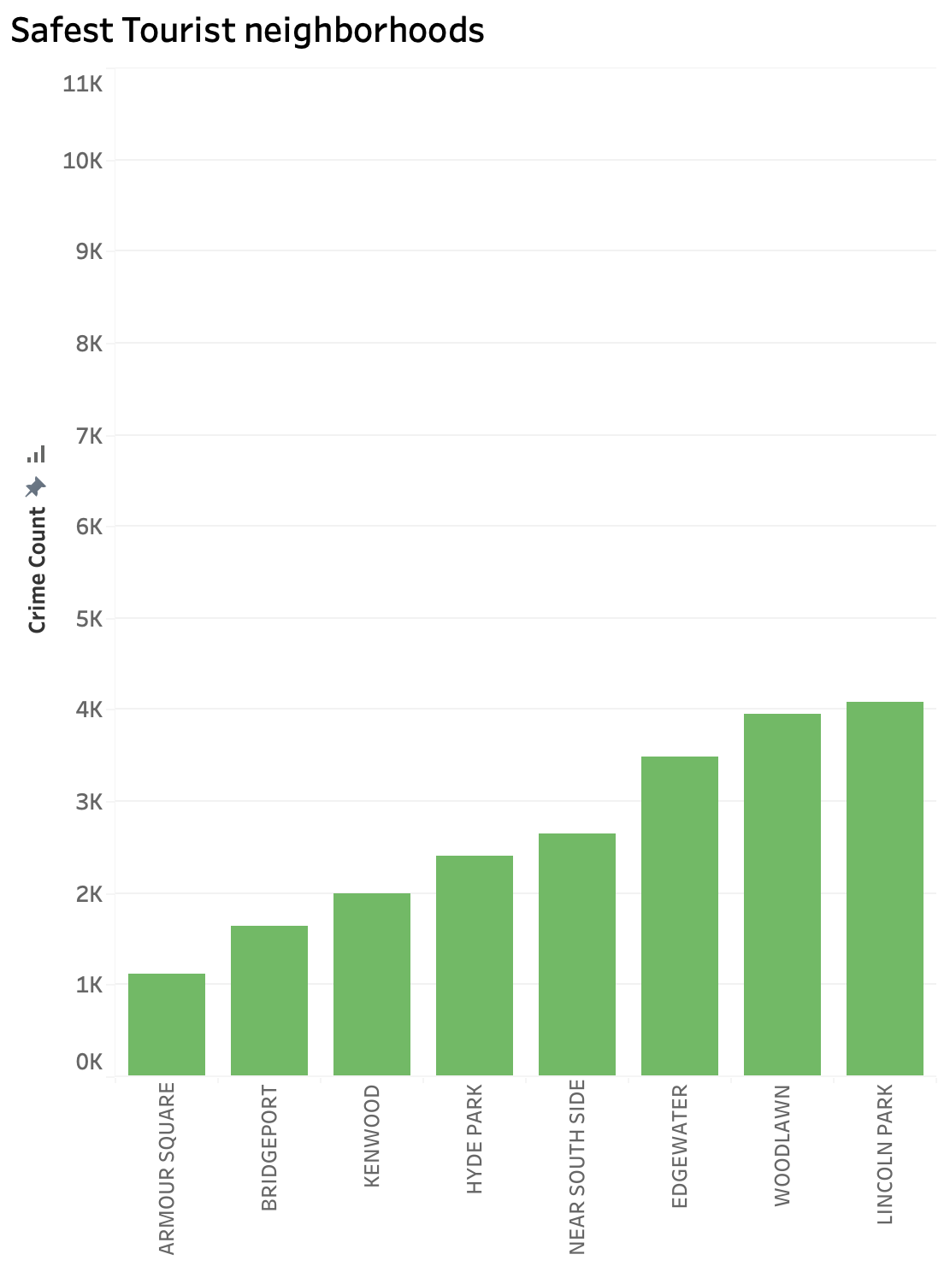
Tourist Neighborhoods

Slide 9
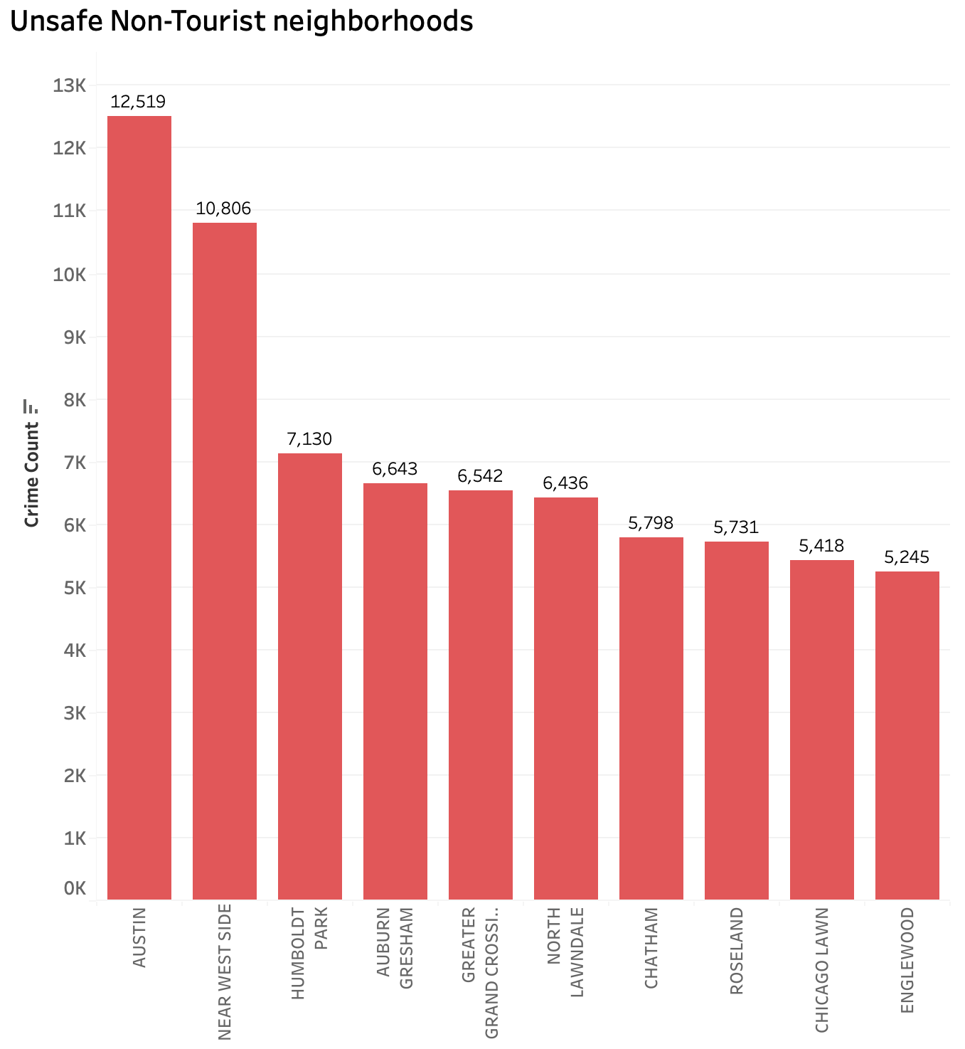
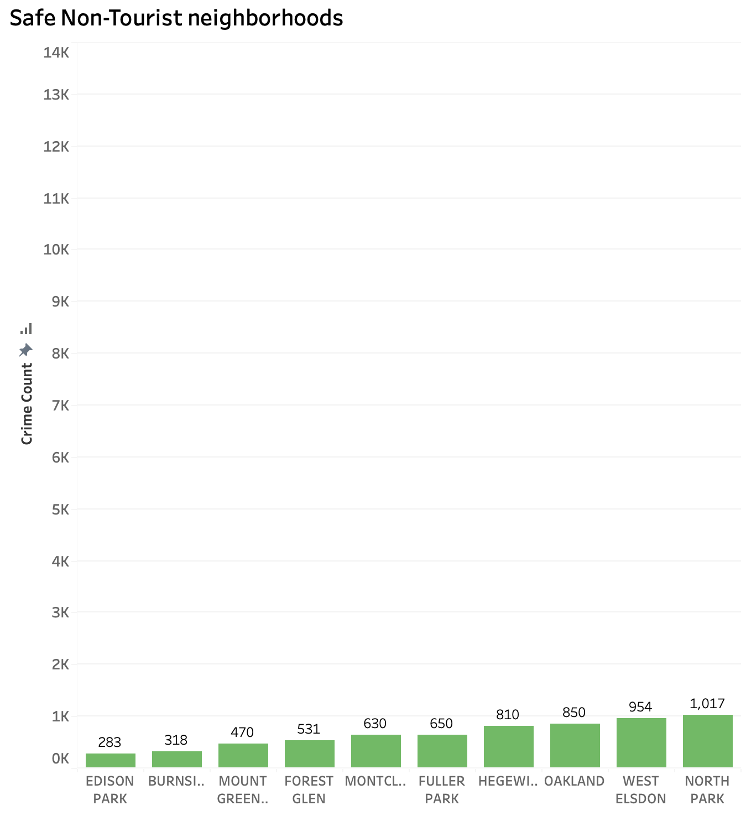
Non-Tourist Neighborhoods

Slide 10
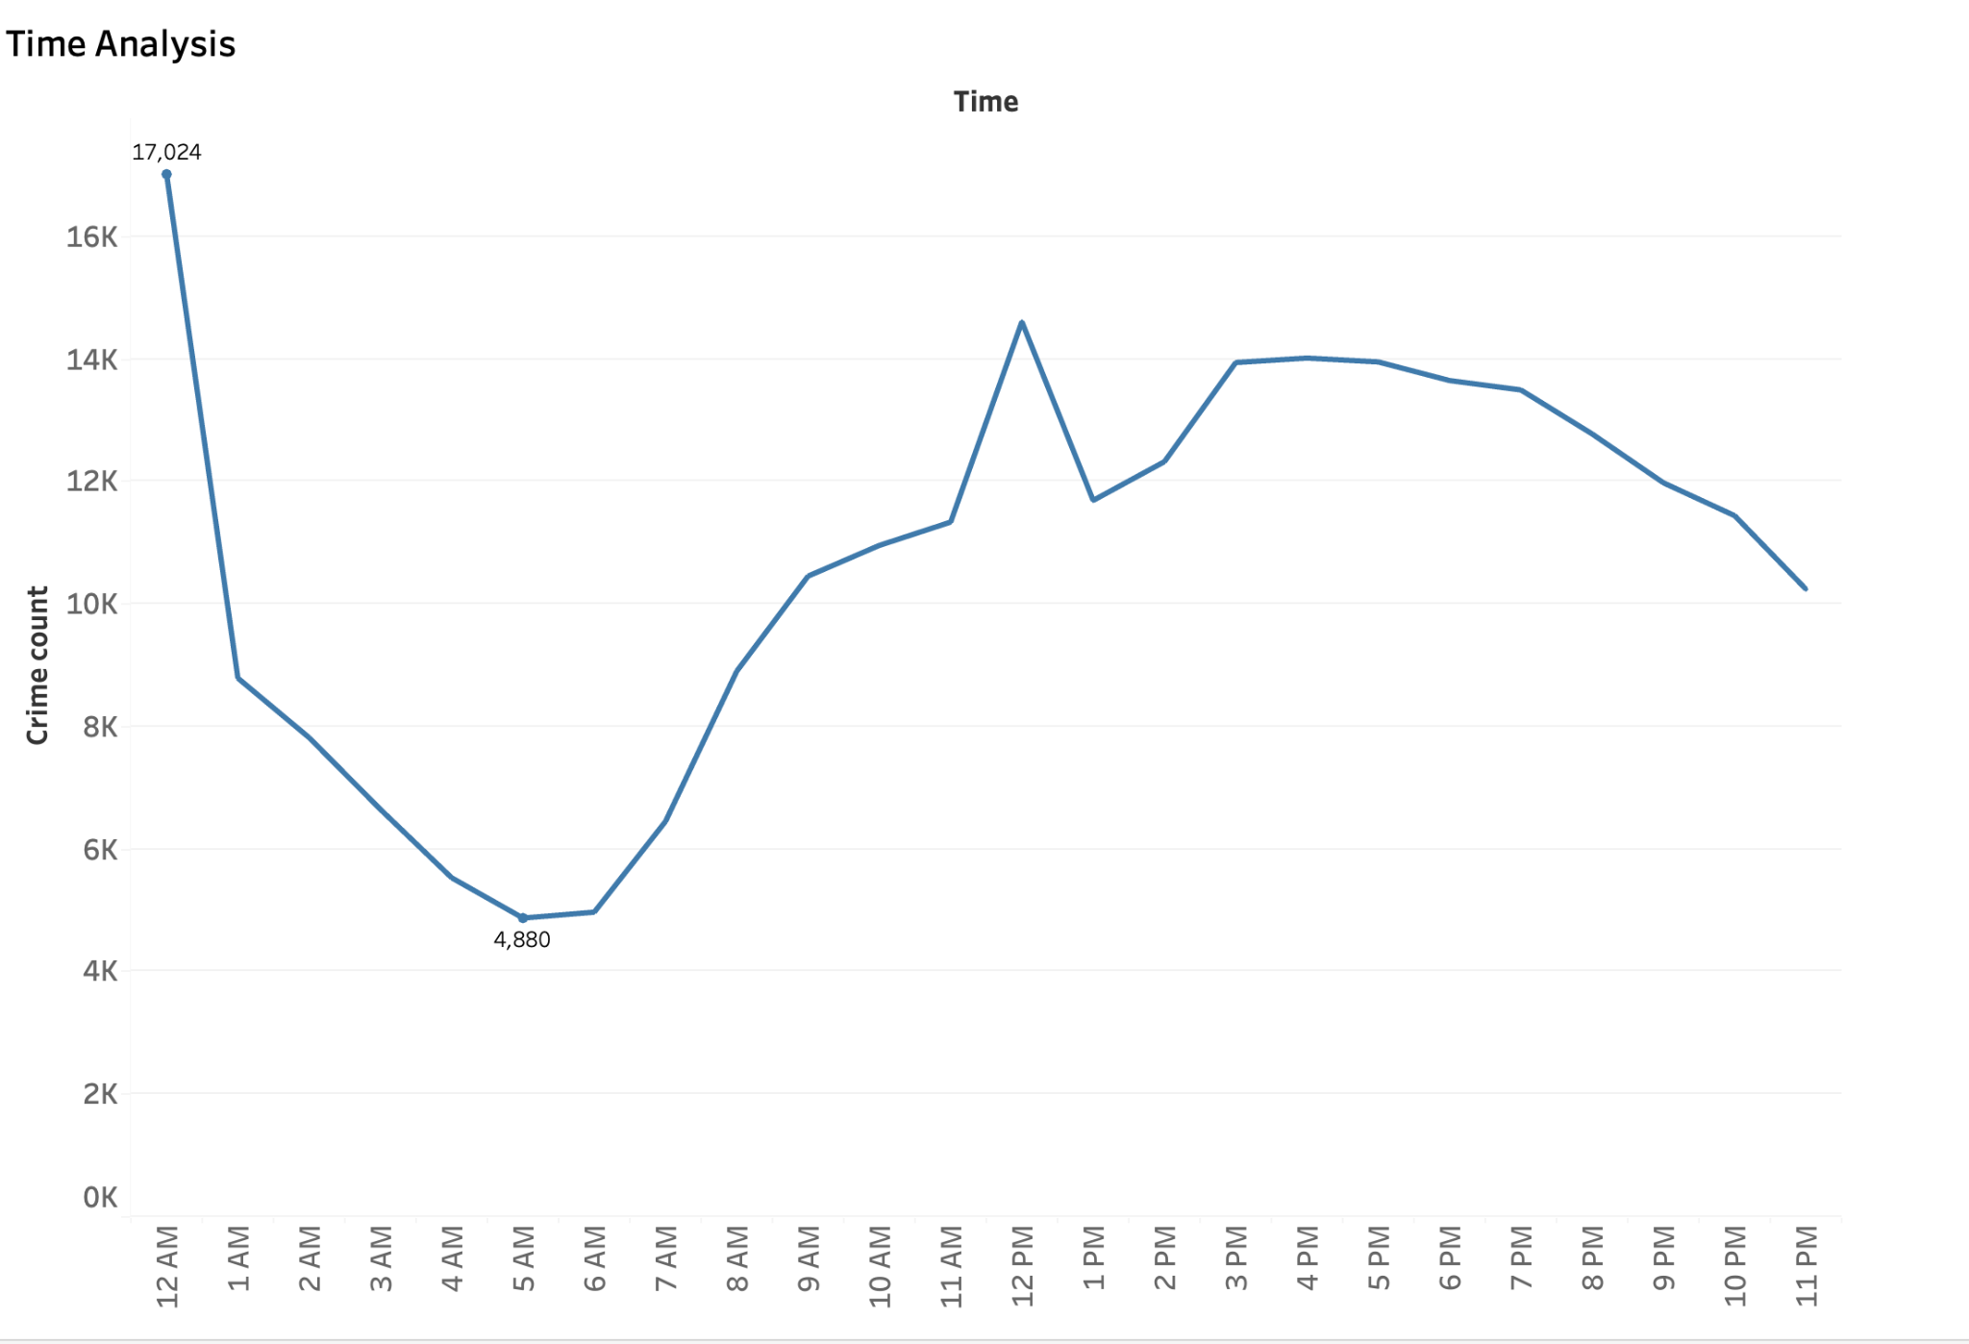
Time Analysis of Crime Rates
Late evenings and nights (8 PM–12 AM) are high-risk times
Significant spike occurs around 12 PM, likely due to increased activity during midday
Early mornings (2 AM–5 AM) consistently exhibit the lowest crime rates.

Slide 11
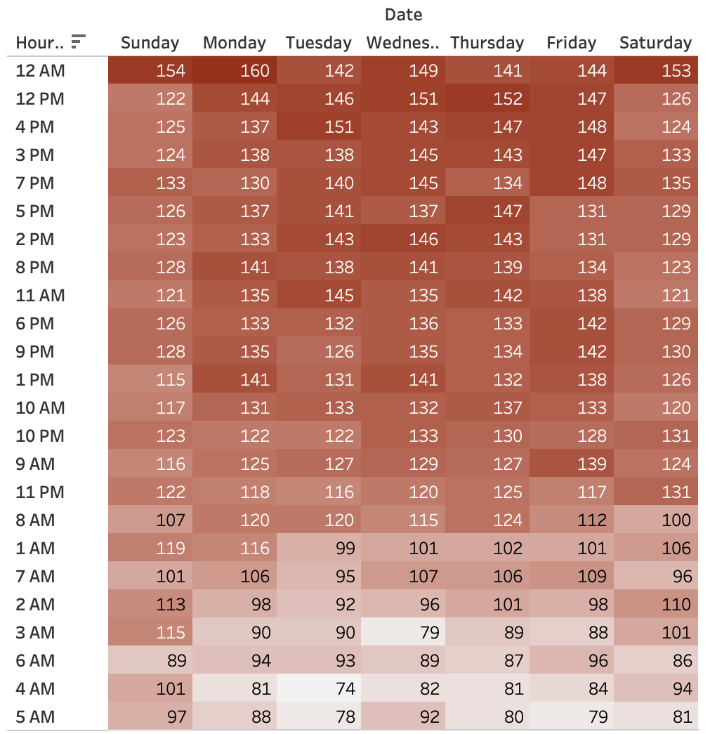
Time of Day and Day of Week Analysis of Crime Rates
Evening to late-night hours (8 PM–12 AM) show elevated crime rates, especially on Sunday, Monday, and Saturday. These might correlate with nightlife or social events.
Midnight (12 AM) consistently has high crime rates across all days.
Elevated crime counts during weekdays (Monday to Friday).

Slide 12
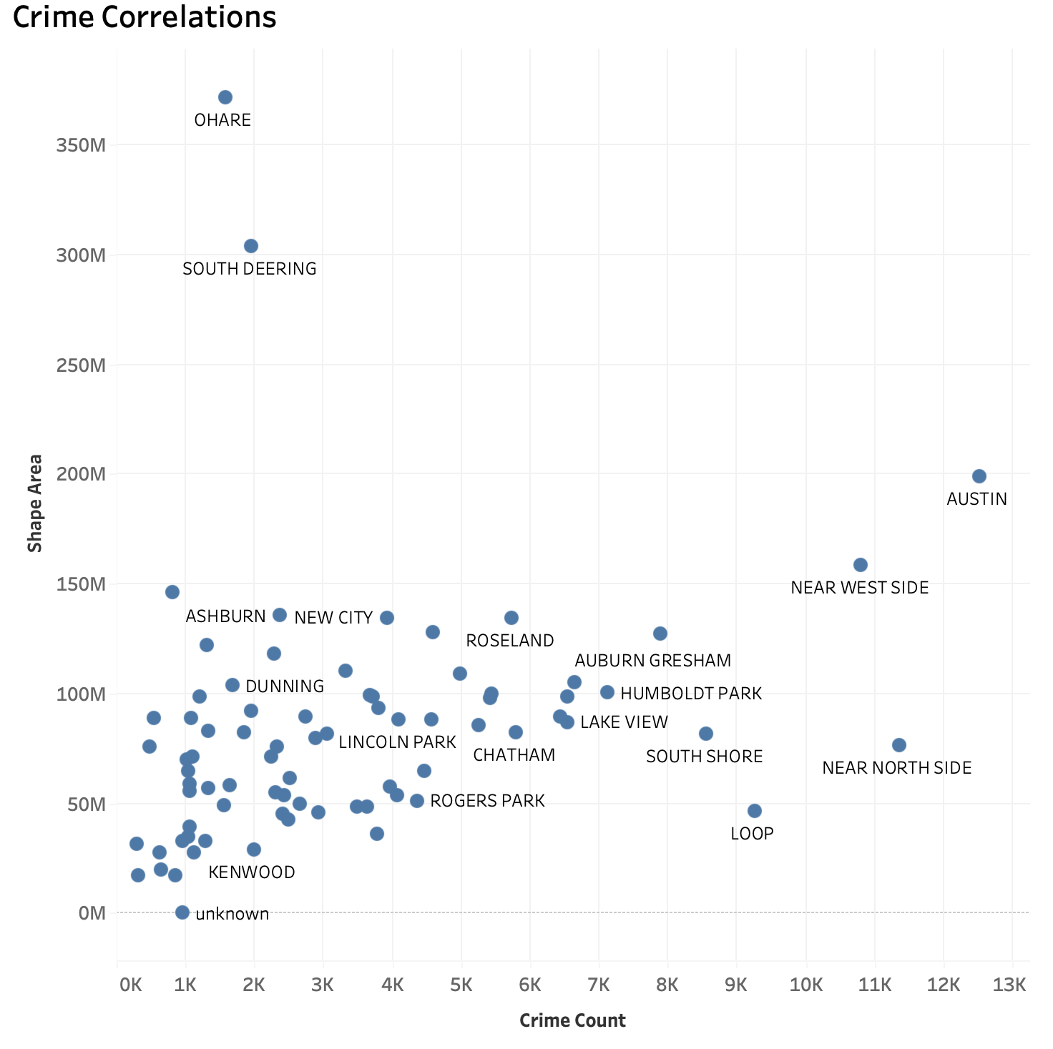
Crime Correlations
O’Hare and South Deering are spacious, low-crime areas ideal for promotion of large-scale tourism
Safe, lesser-known areas like Hegewisch, Ashburn, and Beverly can be promoted as tourism options
Near North Side and the Loop - tourist heavy locations need more strengthening of security.

Slide 13
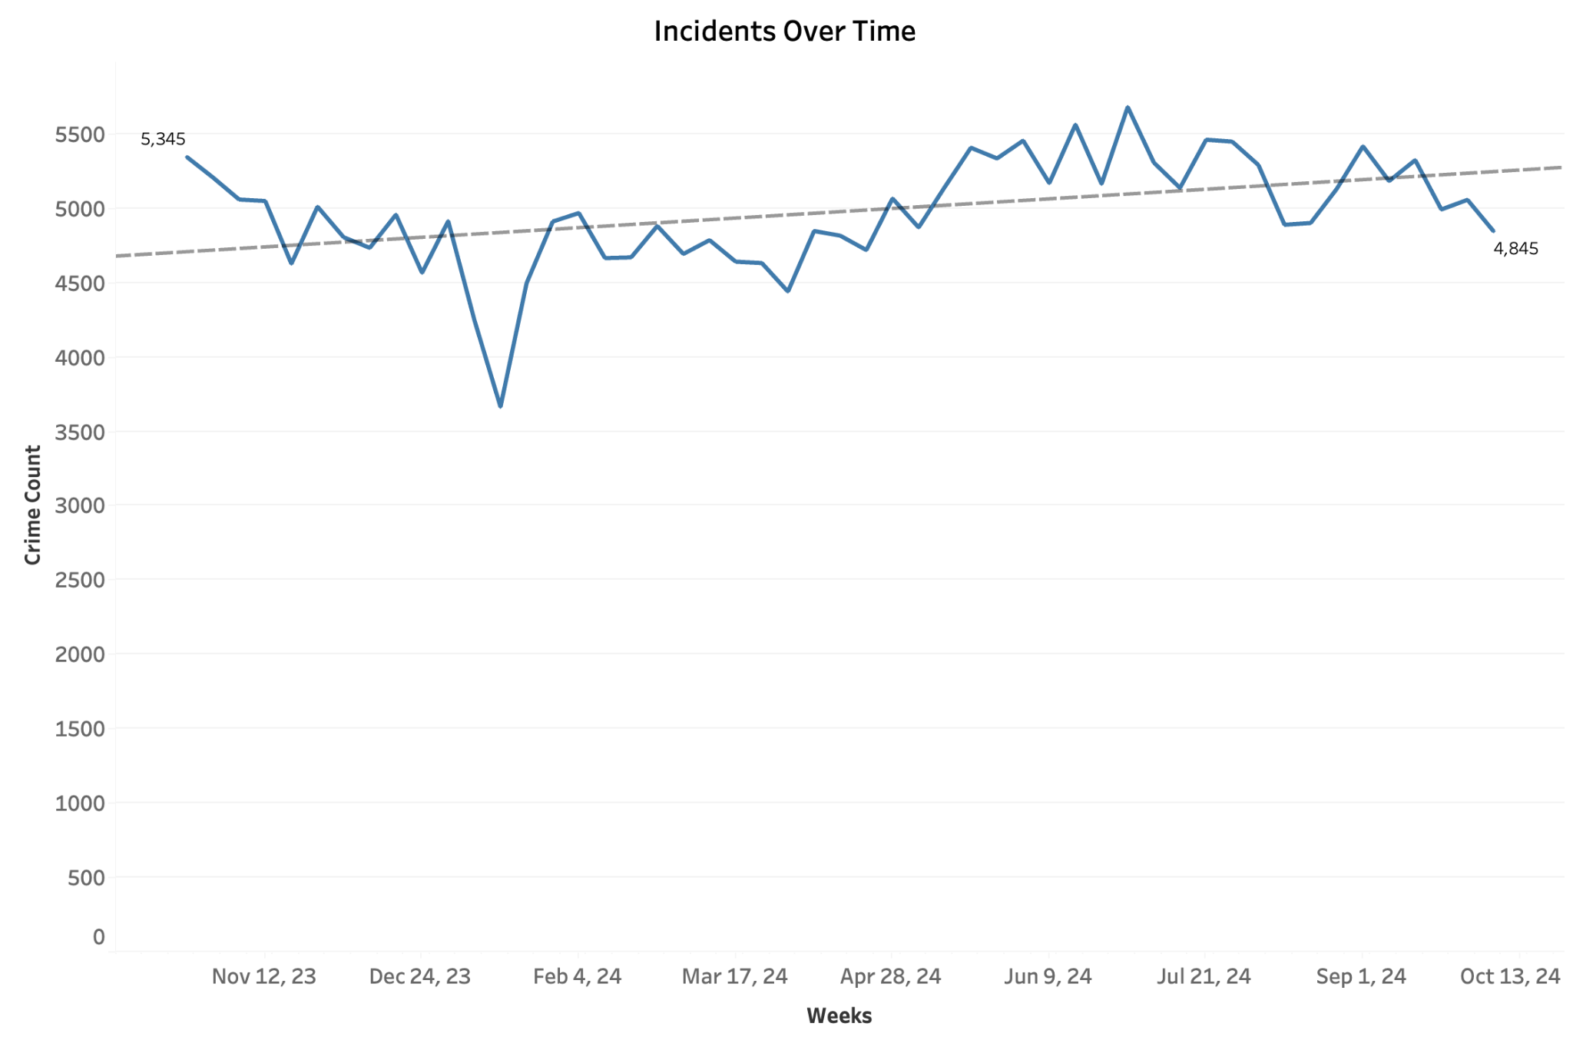
Field and Density Maps For Crime Over Time
Crime incidents show a slight upward trend overall.
A significant dip in crime is observed in late winter, likely due to reduced outdoor activity.
Crime levels stabilize during spring and summer

Slide 14
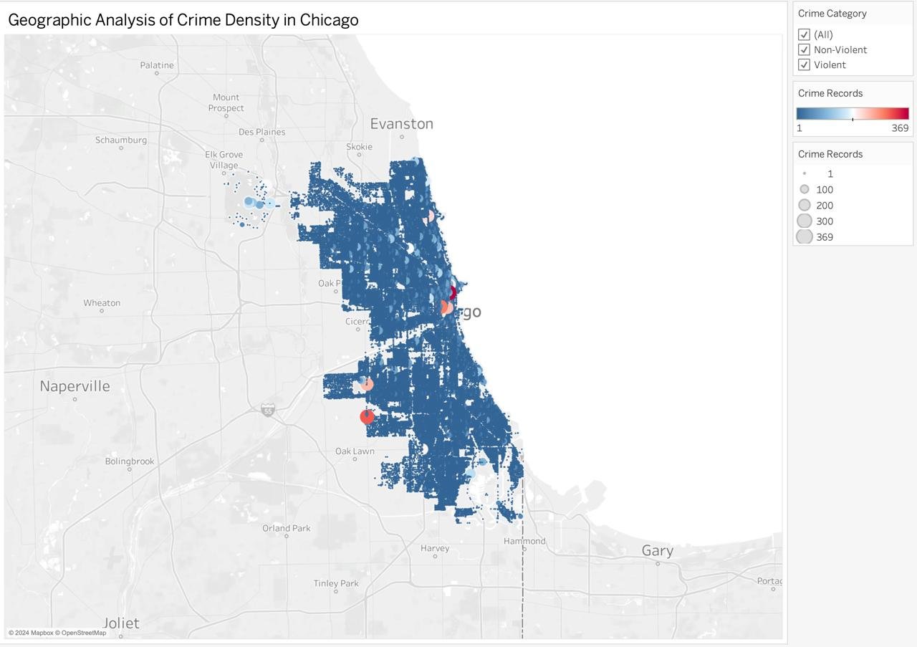
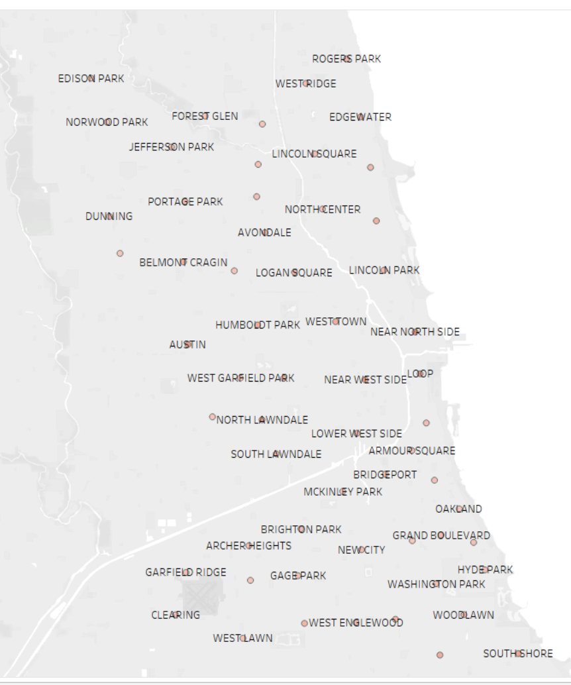
Field and Density Maps of Crime

Slide 15
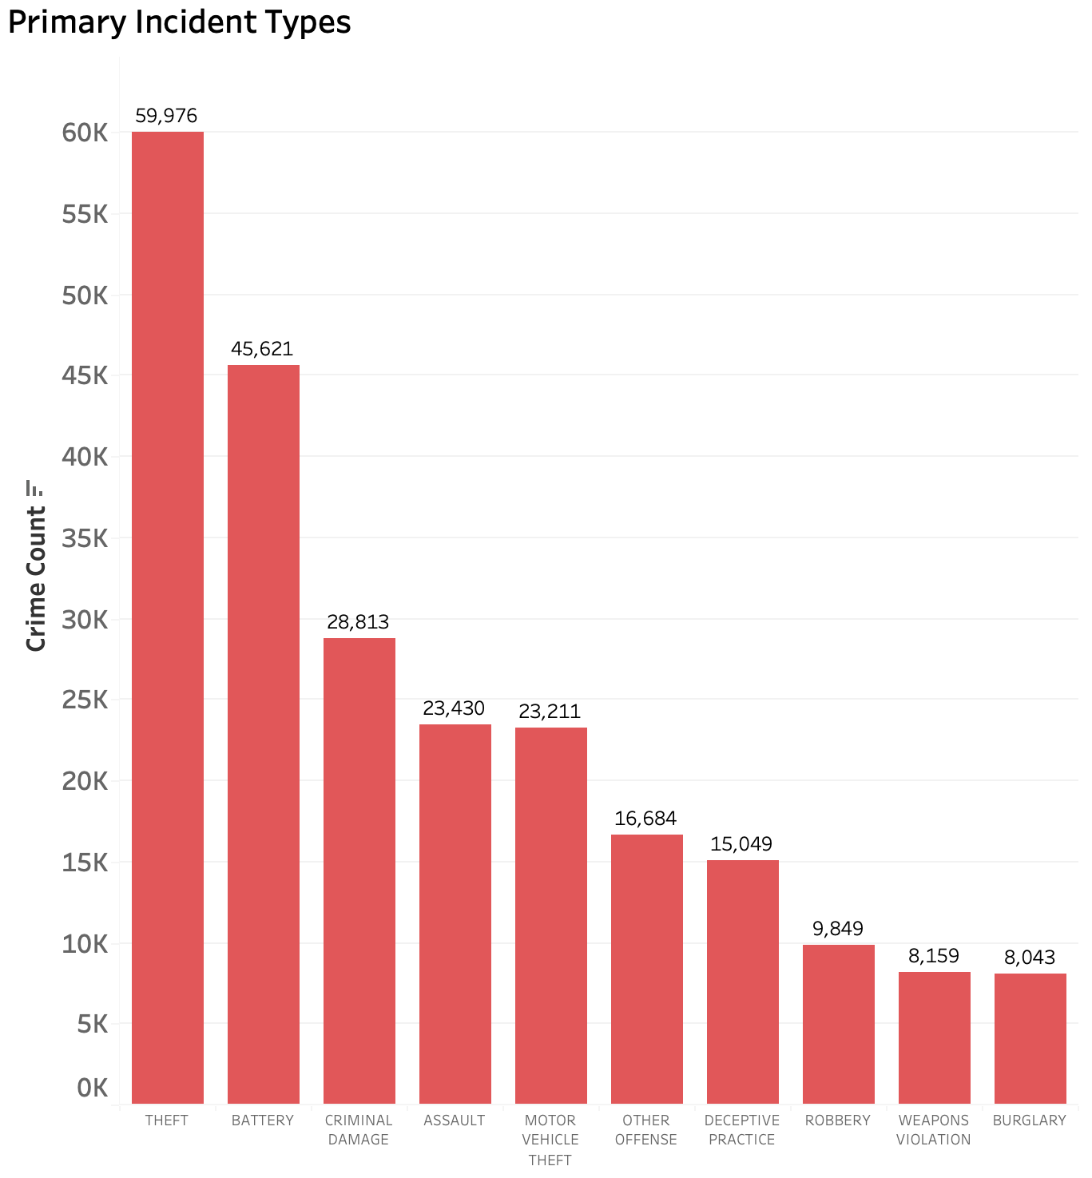
Insights from crime types
Focus on Preventing Theft: Theft is the most common crime, indicating the need for visitor awareness campaigns about securing personal belongings, especially in busy tourist areas.
Battery and assault highlight the importance of visible law enforcement and community safety initiatives to reassure visitors.
Motor vehicle theft is a significant concern, suggesting the need for secure parking facilities and visitor education about protecting their vehicles.
Crimes like burglary and weapons violations are relatively lower, providing an opportunity to market Chicago as safer compared to its crime perception.
Tourist Awareness on Deceptive Practices should focus on educating tourists to avoid scams, particularly in high-traffic areas.

Slide 16
Recommendations to Enhance Safety
& Appeal for Tourism Companies
Promote Safer
Zones
Highlight O’Hare, South Deering, and safe, lesser-known areas like Hegewisch, Ashburn, and Beverly as low-crime, family-friendly destinations. Encourage daytime exploration in tourist areas for added safety.
Leverage Seasonal and Crime Trends
Market Chicago as a safer city during late winter when crime dips, and during morning and afternoon hours, which report lower incidents in tourist areas. Highlight stable safety levels in spring and summer for sustained tourism promotion.
Launch Visitor Awareness Campaigns
Educate tourists on securing belongings to prevent theft (the most common crime) and avoiding deceptive practices in high-traffic zones. Promote best practices for vehicle security to reduce motor vehicle theft risks.

Slide 17
Advanced Measures for a
Secure Tourism Experience
Strengthen Security in High-Risk Areas and Times
Increase visible law enforcement and security measures in The Loop and Near North Side, particularly during high-risk times like late evenings (8 PM–12 AM) and midnight, as well as on weekends (Saturday, Sunday, Monday).
Enhance Safety Infrastructure Around Nightlife and Events
Focus on security measures during nightlife hours (8 PM–12 AM) and late weekends to reduce risks associated with elevated crime during these periods, particularly in nightlife hubs.

Slide 18
Conclusion & Lessons Learned
Data Quality is Critical: Addressing missing values and inconsistencies was essential to ensure reliable analysis.
Normalization Matters: Standardizing time, date, and location data improved temporal and geospatial insights.
Tourism-Specific Insights Are Key: Differentiating tourist vs. non-tourist trends revealed critical patterns for tailored strategies.
Visualization Simplifies Complexity: Dashboards and maps effectively communicated crime patterns to stakeholders.

Slide 19

Thank You
We appreciate your time and feedback.

